Slide 1
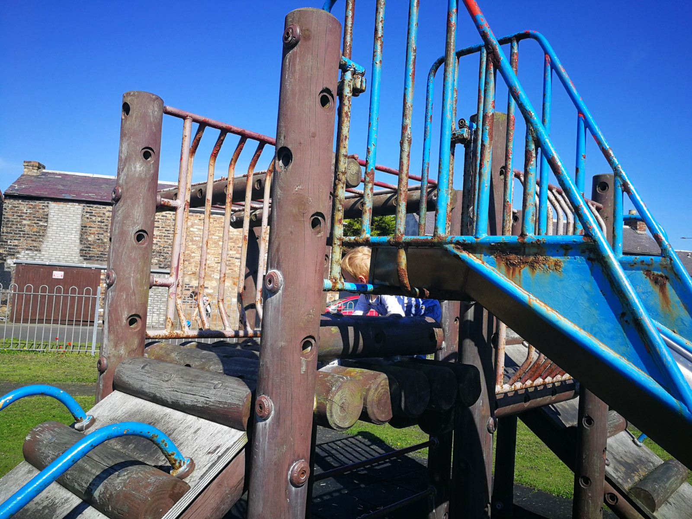
a new ST monans children's play Park A project proposal by St MonaNS Charitable Fund (Scottish registered charity. SC048605) St Monans & Abercrombie Community Council January 2020
Proposal and costs

Slide 2
Current Play park sites
Queen Margaret Street park
Small site which has had several items removed as the equipment has been deemed unsafe by Fife Council.
Will be removed to allow for an access road into the new proposed development .The Developers have committed to building a small play area within the new development.
Shoreside park (beside the coastal path)
Very limited in its equipment (and is not conveniently situated to the main population).
Due to budget constraints, it is earmarked for removal by Fife Council.
Newark Street park
Another small park designated for closure by Fife Council due to unsafe equipment.
Hope Place park (on St Monans Common or ‘Mair’)
Equipment which is approximately twenty years old i.e. basic models and provide limited stimulus to toddlers and children. They are also non inclusive.
There was a skate board park on this site but the equipment was removed by Fife Council. However, the infrastructure remains in place and has been incorporated into the refurbished plans.

Slide 3
Proposed Play park site
Hope Place park (on St Monans Common or ‘Mair’)
Well situated within the village
Easy walking distance of both primary school and nursery
Road leading to the park and terrain is level allowing accessibility for wheel chairs, walking aids and buggies (may require some work to further improve accessibility)
Equipment and layout will be inclusive (ie allowing children of all abilities to use it)
Ownership of the playpark (and associated public liability insurance) would remain in the hands of the local council
The proposed refurbishment would meet all relevant health and safety requirements
The renovation and improvement of playparks within the locality was identified as one of the key priorities of the St Monans & Abercombie Community Action Plan (2018 - 2022)

Slide 4
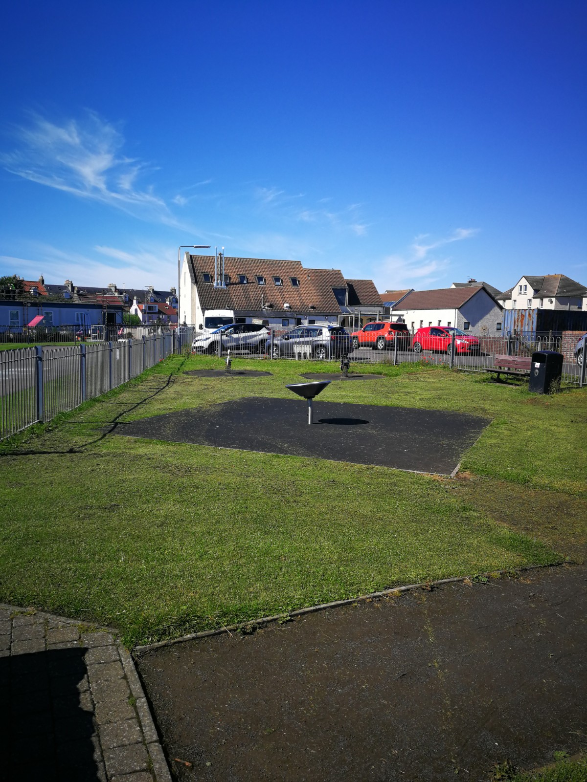
Current Site with limited Equipment

Slide 6
Costs
Source of funding | Amount (£)
Project costs (to provide and install equipment as itemised in manufacturers estimate of 14 October 2020) | 135,355
Consultancy fee for project (to cover all works by Building Services)* | 12,000
Site clearance and site survey (estimate) | 22,645
Resitting of entrance gate and pavement alignment (provisional estimate) | 10,000
TOTAL | 180,000
* As the tendering process goes through Fife Council, we will not be charged VAT at 20%

Slide 7
Funding
Source of funding | Amount (£)
Residents crowd funding goal ^{*1} | 13,000 (7%)
Local business sponsorship goal^{*2} | 6,000 (3%)
Russell Trust | 2,000 (1%)
Common Good Fund^{*3} | 109,000 (61%)
Fife Environment Trust | 50,000 (28%)
TOTAL | 180,000
Based on a population of 1230 (source Statitics.gov.scot, 2019 St Monans &Abercrombie) Individual items of equipment (eg Wilbur whale, Pablo the penguin, etc) could be sponsored. Although CGF guidelines normally funds up to 50% of costs, exceptions can be made if sufficient grounds to benefit the community. See next slide

Slide 8
St monans Common Good Fund
What does a Common Good Fund consist of?
The assets of Common Good Funds in Fife fall into the following categories and income for the funds is derived from the sources as shown:
Property (providing rental income)
Investments (Investment income)
Cash (Interest)
As at June 2020 (confirmed by Fife Council) the St Monans fund stood at £37,940.
In addition, the St Monans fund has significant revenue balances (£172,069) which can be accessed for in year spending.
nb: the £172,069 revenue balance will be capitalised on 31 March 2021, if not accessed by the community.
In correspondence with Fife Council, it has been established that ‘this project would be a great project and an appropriate use of Common Good monies’.
Ultimately it is for Fife Councillors to approve CGF applications, not the Community Council. It can only support an application.

Slide 9
Outline timelines
Crowd Funding launch, January 2021
Common Good Fund application, January 2021
Business sponsorship campaign, Feb/March 2021
Fife Environment Trust & other grant application, March 2021 (nb: FET award is made in late May)
Tender prices back to Fife Council, March 2021
Assuming the project is then fully funded, Fife Council will award the contract and arrange to meet with the contractor to agree expected delivery of the new play area.
Delivery of play equipment can then be a further 12 to 16 weeks (due to the covid impact on the supply network).
On receipt of all the play equipment, contractor will then provide a start date
Possibly mid to late summer

Slide 10
Play park committee and other information
Helen Ironside, Chair of Committee (Community Councillor, Chair of St Monans Primary school PTA)
Victoria Riding, Primary school teacher, parent and resident
Stuart Bridges, Secretary, St Monans & Abercrombie Community Council
Donna Marr, resident
Carol Copland, Treasurer of Committee (Trustee St Monans Charitable fund)
Lyall Stephen, parent and resident
Crowdfunding page: tbc
For further information about our plans, please contact: newstmonansplaypark@gmail.com
Or visit the St Monans website https://stmonans.org.uk

